Slide 1
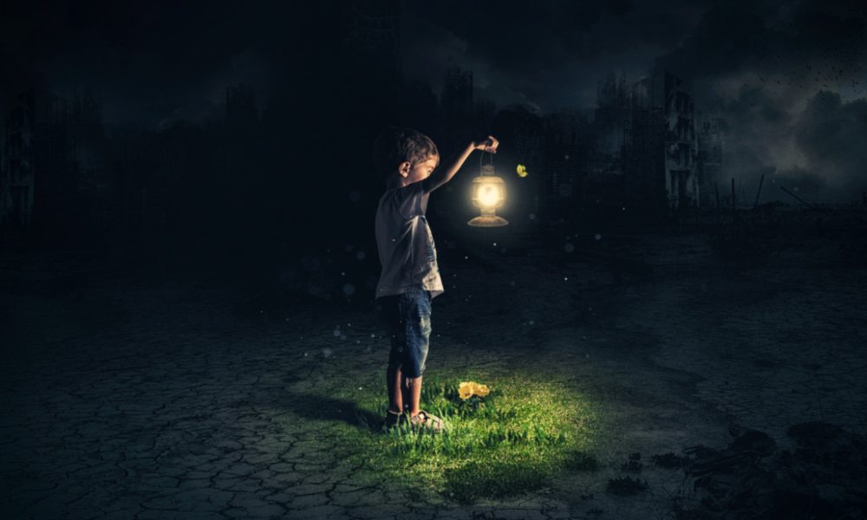
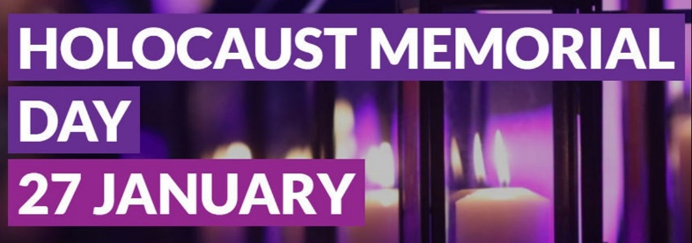
One Family
Genesis 1:26
UNCRC:1 – Everyone under the age of 18 has all the rights in the convention. We have the responsibility to respect the rights of others

Slide 2
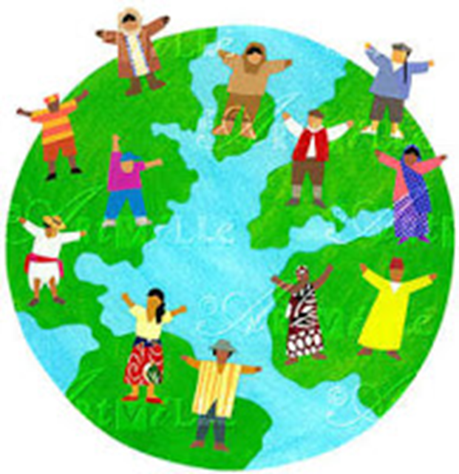
Then God said, “ I shall make human beings in my image, in my own likeness. Let them rule the animal Kingdom and be responsible for the whole earth.”
So God created human beings. He made them in his own image, creating both male and male.
(Genesis 1:26)
Article 1: Everyone under 18 years of age has all the rights in this Convention.
Article 2: The Convention applies to everyone, whatever their race, religion, abilities; whatever they think or say, whatever type of family they come from.
“All men are created equal"
(American declaration of independence)
“One Family – achieving more together” (St Mary’s Junior School)
Notes:
Discuss each of the quotes. Think about what each one means. Think about whether all the people the two articles and quote from the American declaration of independence apply to – is everyone treated this way. For America the next slide will unpick this.

Slide 3
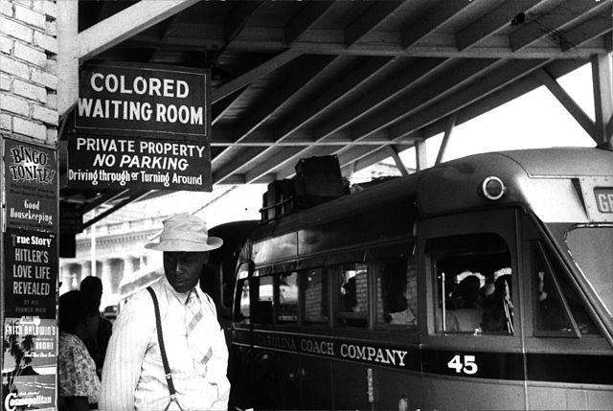
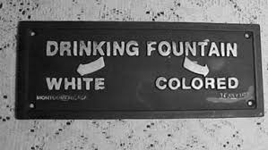
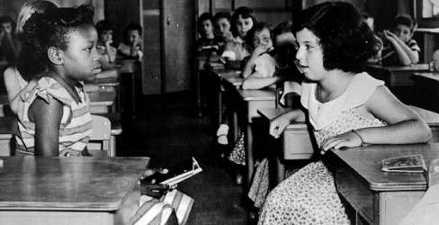
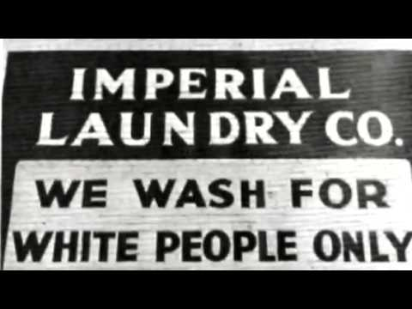
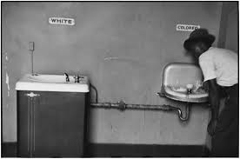
Notes:
In both the United States (segregation) and South Africa (apartheid) – people of different back grounds were treated differently. Look at the pictures can you see the differences – Note the different standards of wash basins. Look at the school picture – the two sides of the classroom are different. How does this make you feel? How would you feel if some of your friends were treated differently?

Slide 4
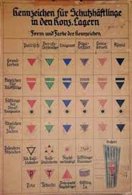
Notes:
During the Second World War. The Nazi party, led by Hitler, decided to treat people differently. You may well have heard about how the Jewish people were treated because of their religion - they had to wear Yellow stars. Children were not allowed to go to school or ride a bike and they were not allowed out after a certain time. In many areas Jewish people were forced to leave their homes and move into really cramped conditions in certain parts of the cities. What you may not not know is that the ways of separating people was far more complicated – the poster gives some indication of this. The purple star was worn by Jehovah’s witnesses but Hitler also did not like anyone who did not conform to his ideas and therefore priests and nuns were targeted, and Roma Gypsies for example. The red triangle was worn by anyone who stood up to the Nazis and spoke out about their ideas and they became political prisoners.

Slide 5
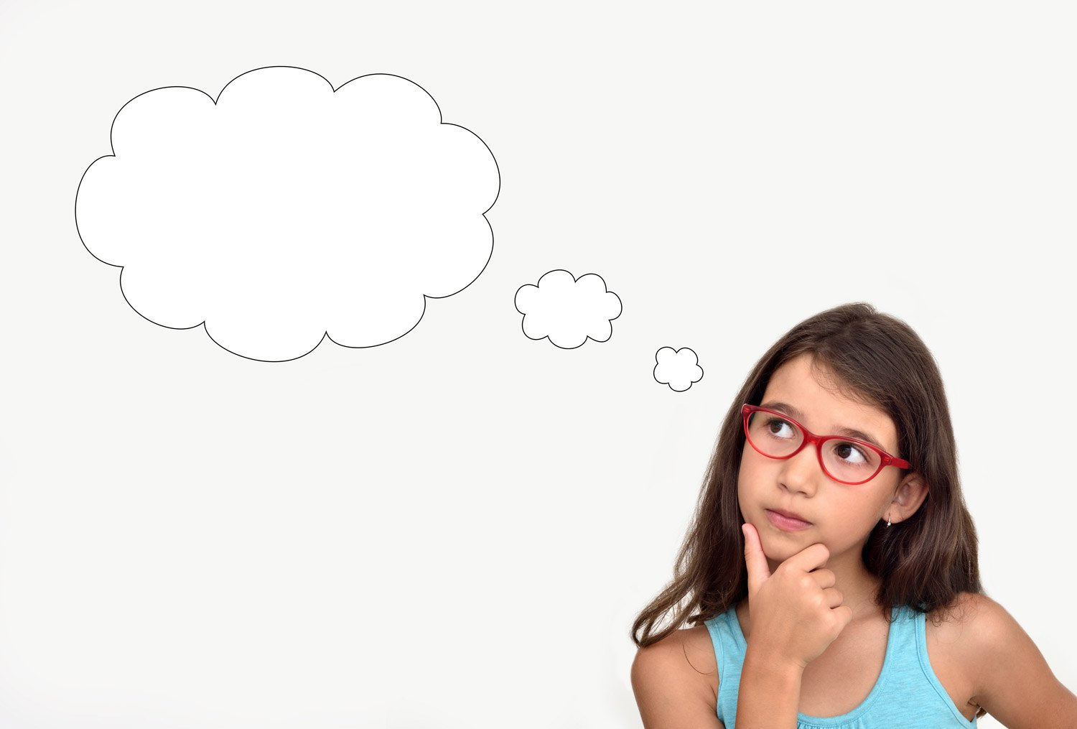
Time to think
Notes:
Following the last slide you might just want some quiet time to take this in and think about it.

Slide 6
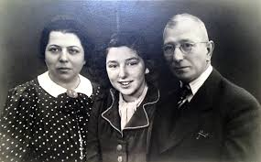
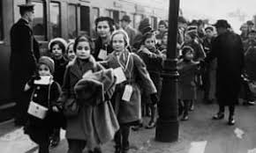
Susanne Kenton a Survivor
Notes:
Read the story in the separate notes. The bottom picture is of children leaving on the Kindertransport.

Slide 7
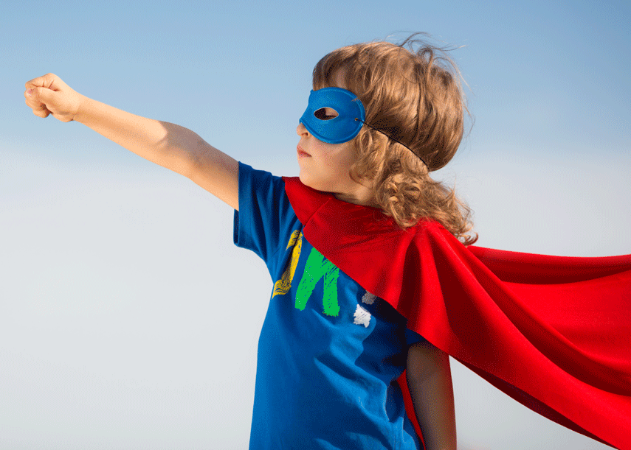
In John’s Gospel Jesus said to his disciples:
12 This is my commandment, That you love one another, as I have loved you.
13 Greater love hath no man than this, that a man lay down his life for his friends.
What small sacrifices can we make for those we know, those we may meet in the future and those we will never meet?
How can you be a courageous advocate?
Notes:
Our value of One Family is all about treating others as you would wish to be treated. Look at the quote above – many people over time have given their lives for others standing up for what they believe is right. You will be glad to hear that no-one expects you to do this – BUT what small sacrifice could you make to show love for someone – this may be someone you know, a neighbour or in fact someone you have not met – through charities for example. Courageous advocacy is a concept we look at in RE – not just recognising that something may be wrong but thinking about what we can do, it does not have to be huge, to make a difference.

Slide 8
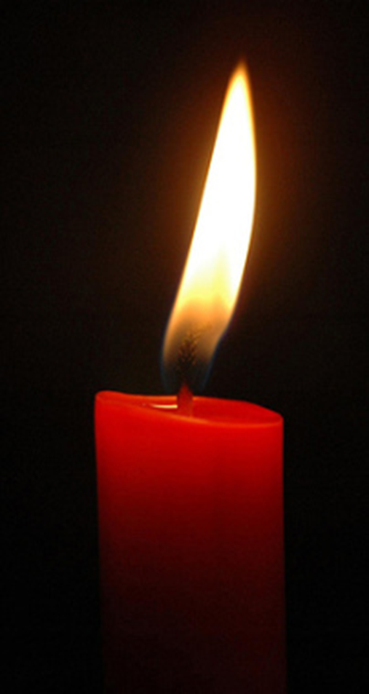
Dear God
We thank you that we live in a safe country where we can be ourselves without being hurt by others.
Today we especially remember people who suffered in the Holocaust, or have been hurt by others just because they are hated for being themselves.
We pray that they may feel brave because you love and care for them.
Please give us the courage to stand together when we know things are wrong.
We pray that people who are filled with hatred, especially against Jewish people, may have a change of heart and show kindness in the world instead.
We ask all this in Jesus’ name.
Amen https://www.youtube.com/watch?v=rCtPhSZS3CE
Notes:
Read the prayer together or follow the link to watch a video of children from across the diocese, including some of ours, reading it last year.

Slide 9
Shalom Shalom
May peace be with you
throughout your days
In all that you do may peace be with you
Shalom Shalom

Slide 10
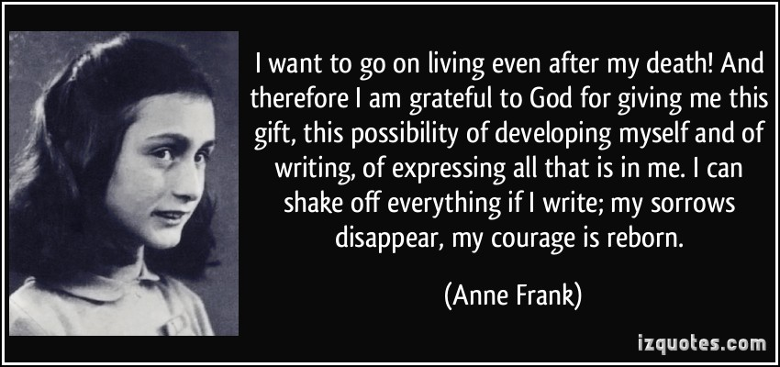
How can we help to keep the memory alive?

Slide 11
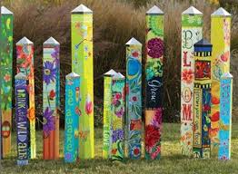
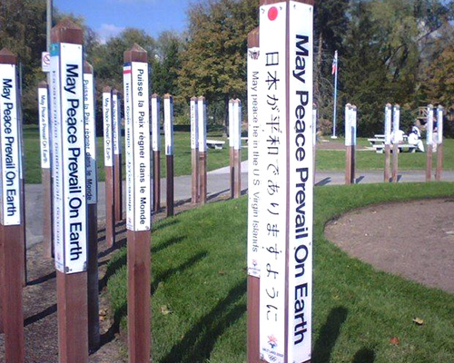
Peace Poles
Have a look at the Peace Poles that we made in school last year (by the Pupil Entrance)to mark the 75th anniversary of the end of WW11.

